Slide 1

PRACTICAL SUBMISSION DATA SCIENCE WITH APACHE SPARK WITH BIG DATA
Submitted by
Amit Sharma
Bsc Data Science
Submitted To
Miss Neema Jha
Assistant professor
AAFT (SODS)
AAFT | SODS | 2024

Slide 2
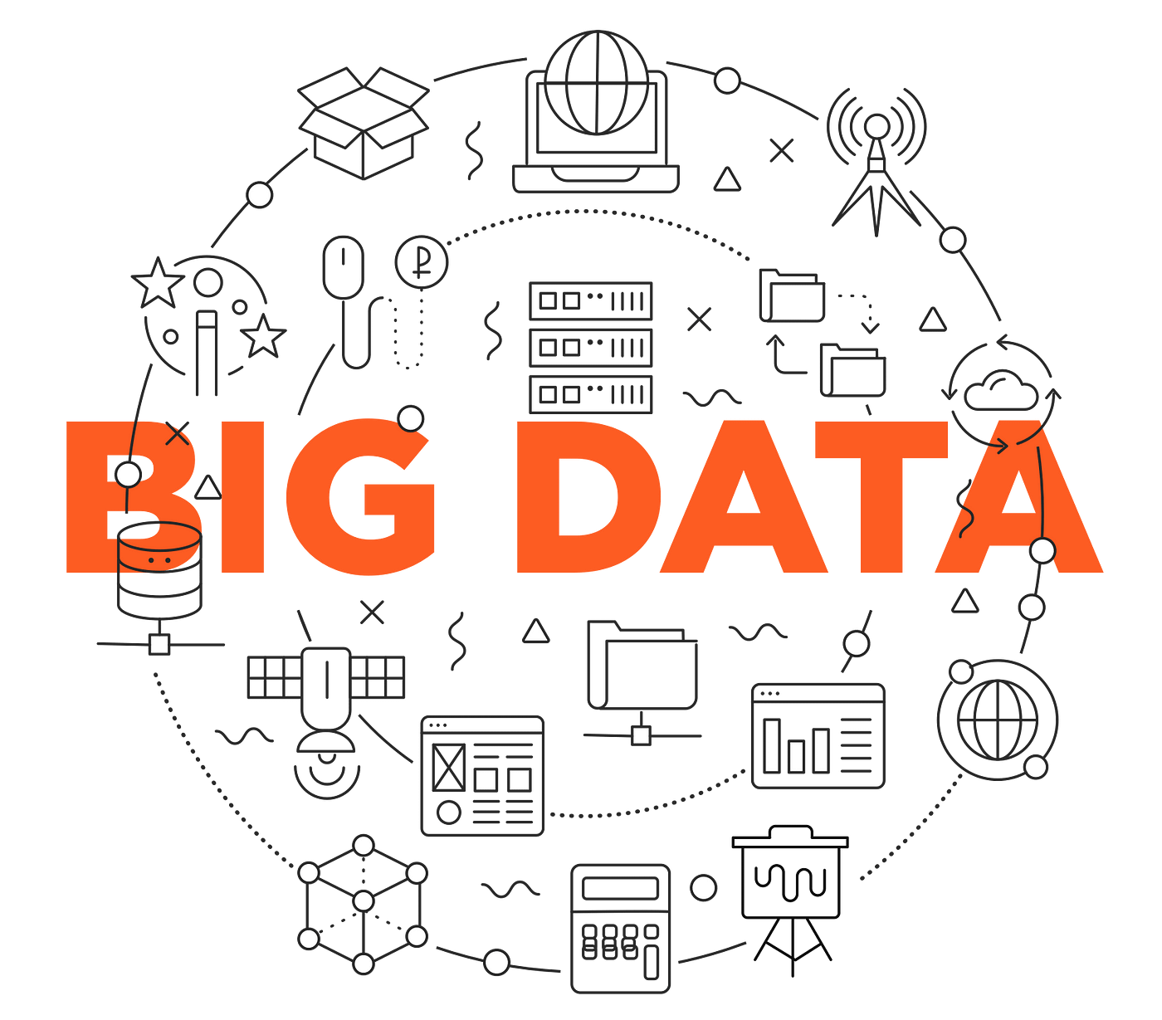





Topics
5
6
3
1
Map Reduce
4
2

Slide 3
Topics
5
6
3
1
Map Reduce
4
2

Slide 4
Introduction to

Slide 5
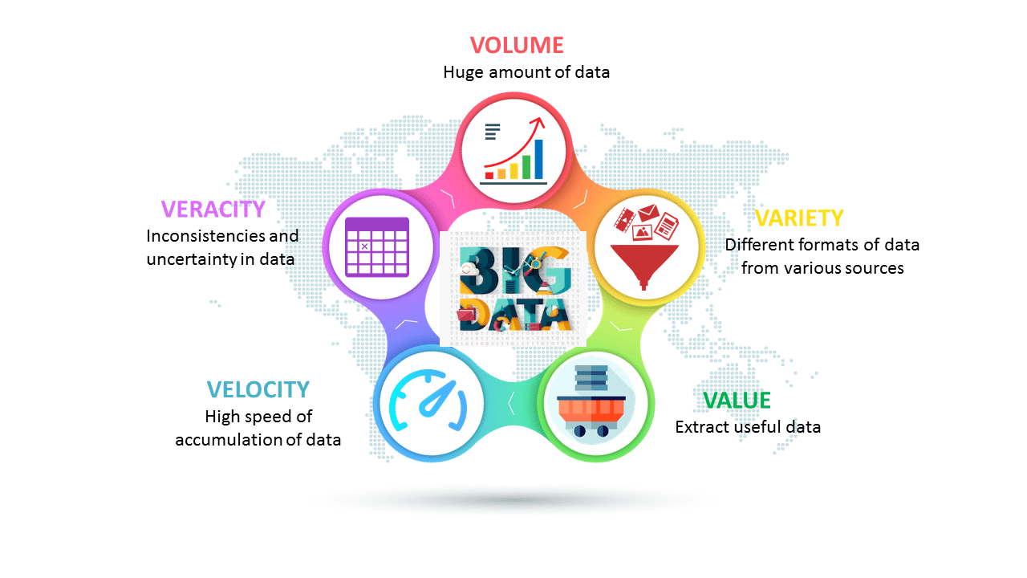
What is Data?
Data is defined as individual facts, such as numbers, words, measurements, observations or just descriptions of things.
For example, data might include individual prices, weights, addresses, ages, names, temperatures, dates, or distances.
Big Data
Big Data is a collection of data that is huge in volume yet growing exponentially with time.
It is a data with so large size and complexity that none of traditional data management tools can store it or process it efficiently. Big data is also a data but with huge size.

Slide 6
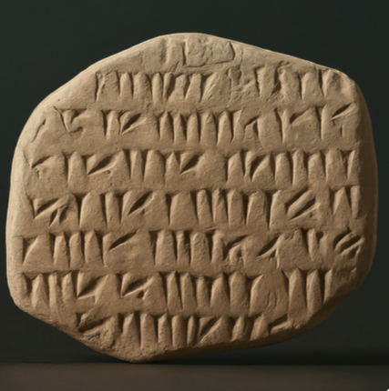


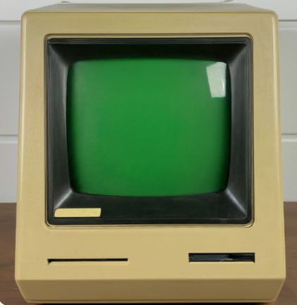
Evolution of Big Data
Big Data in demand since last few years, but evolution spans across not years, rather decades.
1. Early Records (3000 BC and before):
Clay tablets used by Babylonians for record-keeping:
3. The Mainframe Era (1950s and 1960s):
Mainframe computers used for data processing and storage:
2. The Age of Machines (1800s):
Punch cards developed by Herman Hollerith for the first US census in 1890:
4. The Rise of Personal Computers and Relational Databases (1970s and 1980s):
Early personal computers and relational databases like SQL:

Slide 7

5. The "Big Data" Term Emerges (1990s):
Father of Big Data (John R Mashey).
John Mashey is credited with popularizing the term "Big Data" in the early 1990s.
World Wide Web: The internet boom leads to exponential data growth:

Slide 8






Slide 9


Slide 10

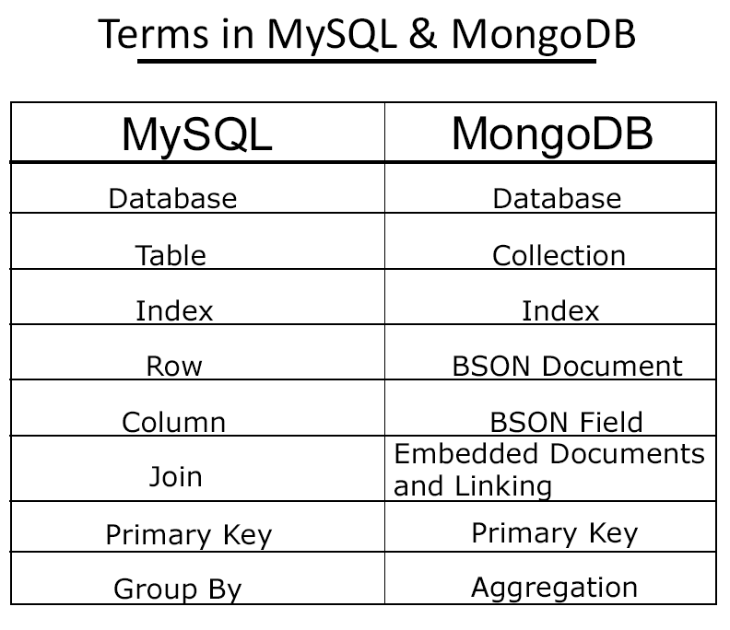
MongoDB
A NoSQL database based on a document model.
Stores data as collections and documents similar to JSON format.

Slide 11
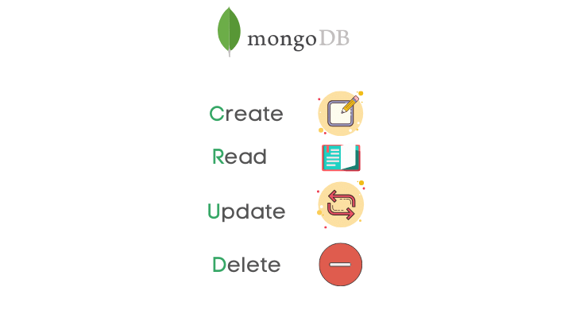
CRUD OPERATIONS

Slide 12
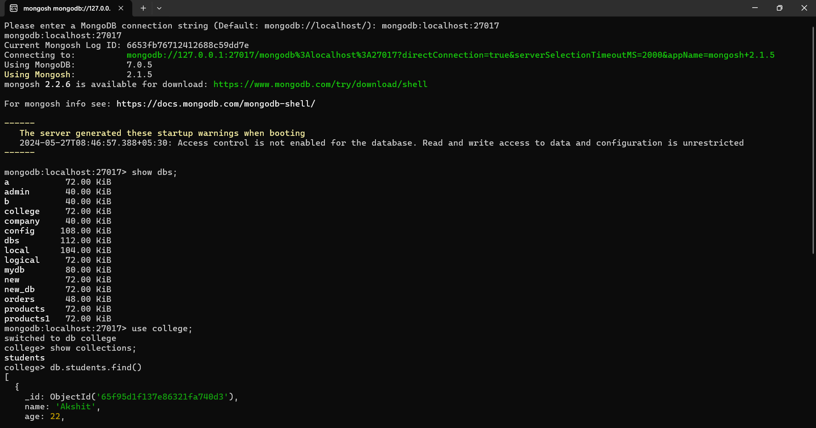
Codes

Slide 13
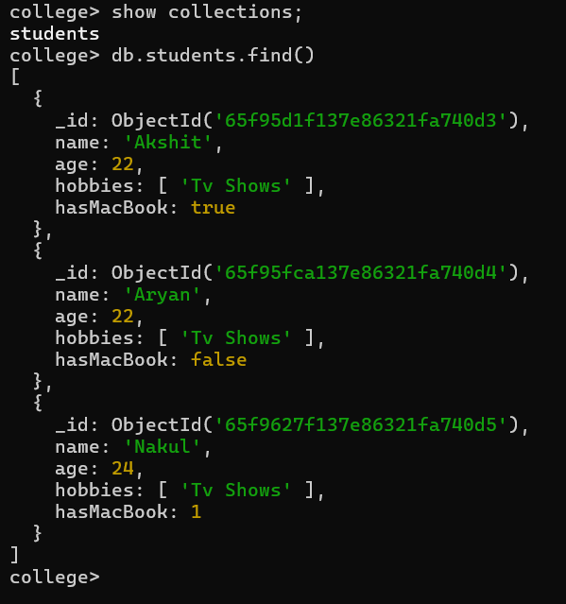
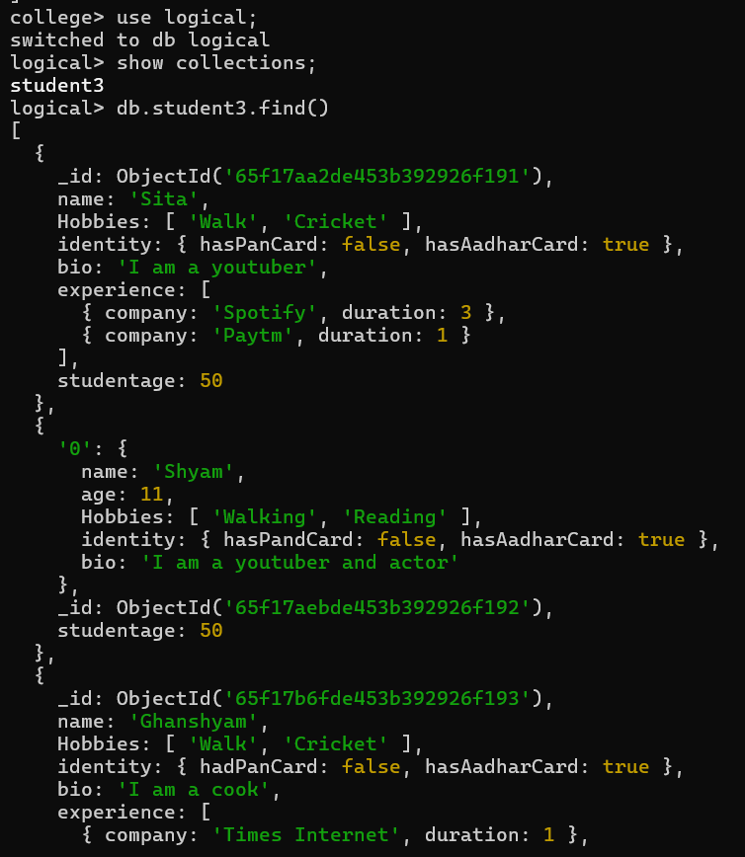

Slide 14
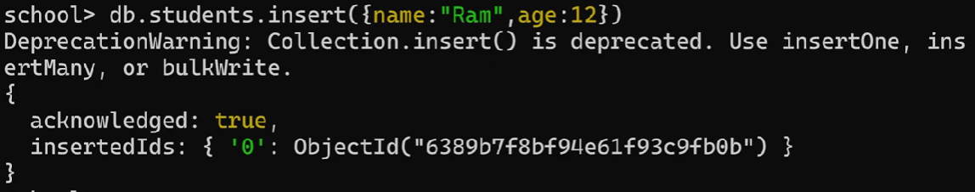
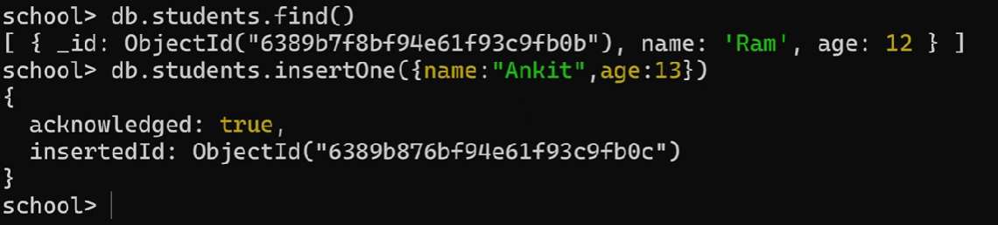
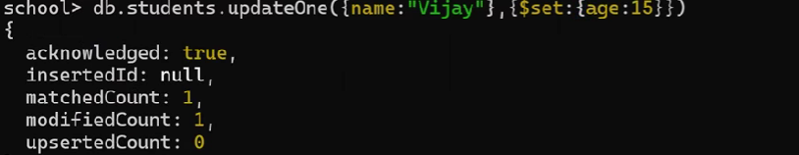

CREATE READ UPDATE DELETE

Slide 15
Big data technologies and Databases Hadoop

Slide 16
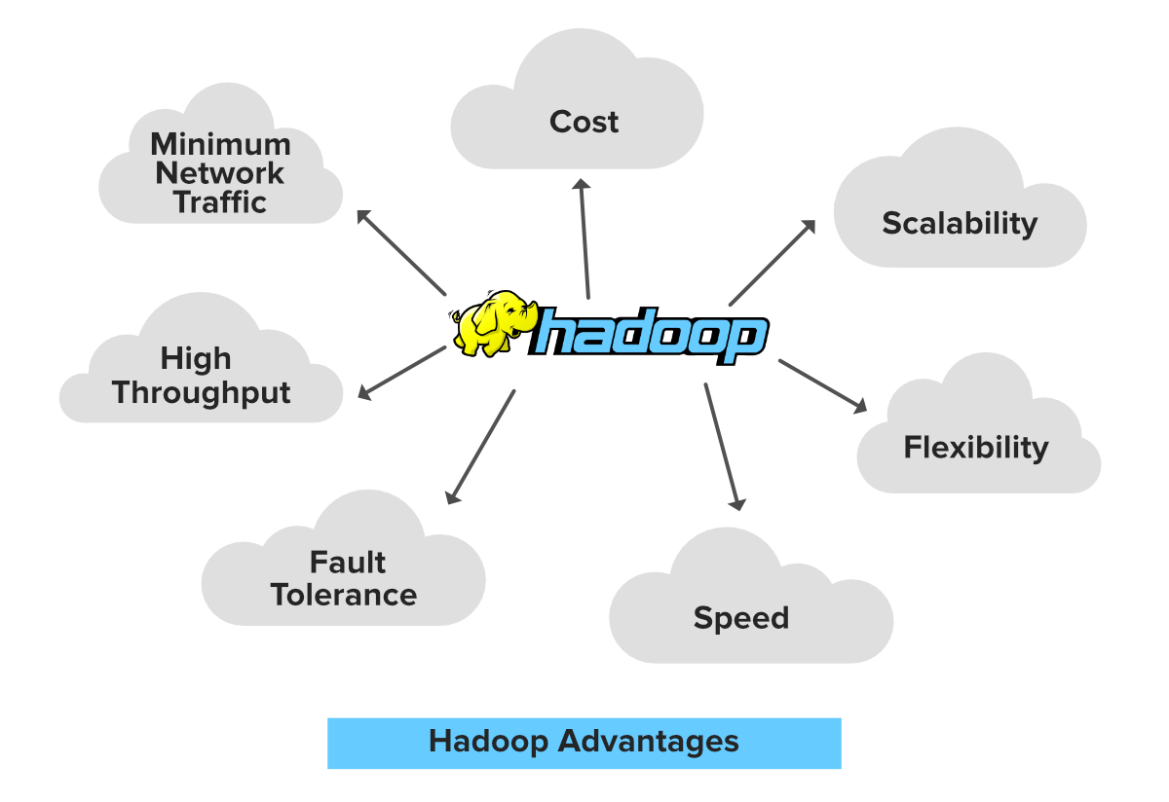
Hadoop
Hadoop is an Apache open source framework written in java that allows distributed
processing of large datasets across clusters of computers using simple programming
models.
The Hadoop framework application works in an environment that provides distributed
storage and computation across clusters of computers.
• Hadoop is designed to scale up from single server to thousands of machines, each
offering local computation and storage.

Slide 17
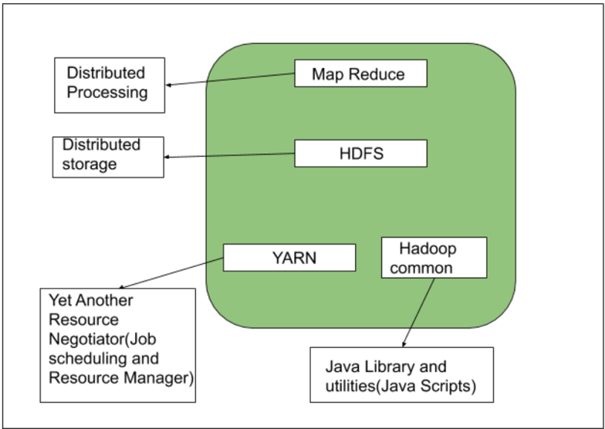
Components of Hadoop

Slide 18
1. Hadoop Common
Description: Provides the necessary libraries and utilities required by other Hadoop modules.
Function: Acts as the foundation for the Hadoop ecosystem, containing common utilities that support the other Hadoop subprojects.
2. Hadoop Distributed File System (HDFS)
Description: A distributed file system designed to run on commodity hardware.
Function: Stores large datasets across multiple machines, providing high throughput access to application data. It ensures fault tolerance by replicating data blocks across multiple nodes.
3. Yet Another Resource Negotiator (YARN)
Description: A cluster management technology.
Function: Manages and schedules resources (CPU, memory) for running applications. It acts as the operating system for Hadoop, allowing multiple data processing engines to handle data stored in a single platform.
4. Hadoop MapReduce
Description: A programming model for large-scale data processing.
Function: Processes data in parallel across the Hadoop cluster. It breaks down a large data processing job into smaller tasks and executes them concurrently across the nodes.

Slide 19
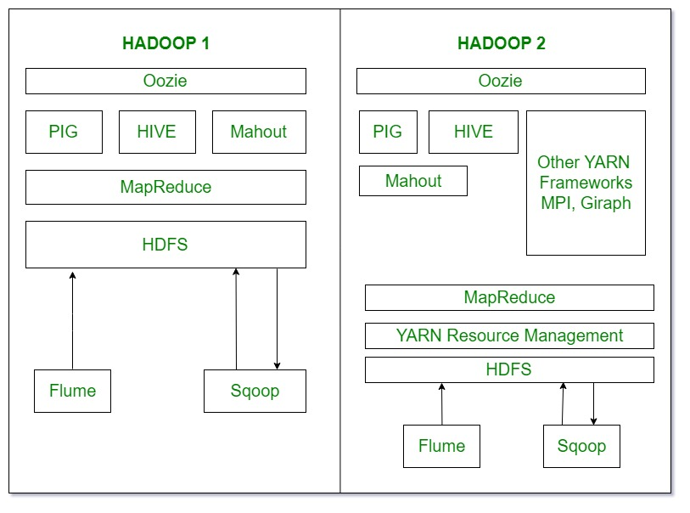
Hadoop Ecosystem

Slide 20
Hadoop Commands
2. create directory in HDFS:
hdfs dfs -mkdir /user/cloudera/dir1
hdfs dfs -mkdir /user/cloudera/dir2
4. copy from local file system to HDFS :
hdfs dfs -copyFromLocal /home/cloudera/test.csv /user/cloudera/file_2
5. moveFromLocal: Works similarly to the put command, except that the source is deleted after it is copied.
hdfs dfs -moveFromLocal localfile1 localfile2 /user/cloudera/hadoopdir
6. Copy from HDFS to Local
hdfs dfs -copyToLocal /user/cloudera/test.csv /home/cloudera/test.csv
1. To list the files in HDFS:
hdfs dfs -ls
hdfs dfs -ls /user/cloudera/
3. listing files in hadoop :
hdfs dfs -ls /user/cloudera/ #list files
hdfs dfs -ls /user/cloudera/emp #list files in emp directory
7. To view the contents of a file :
hdfs dfs -cat /user/cloudera/student.txt

Slide 21
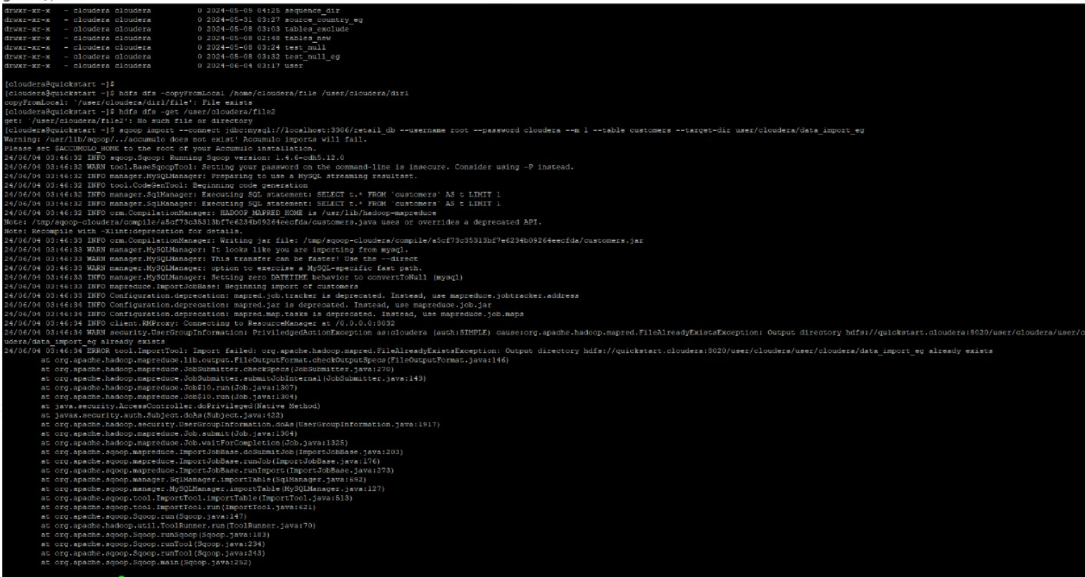

Slide 22
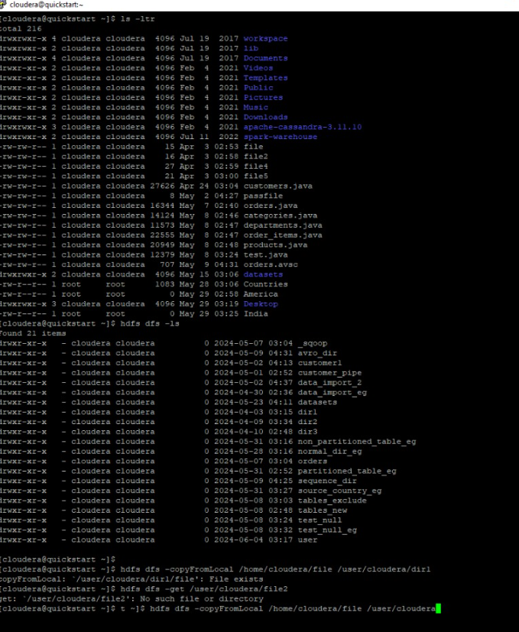

Slide 23
Map Reduce

Slide 24
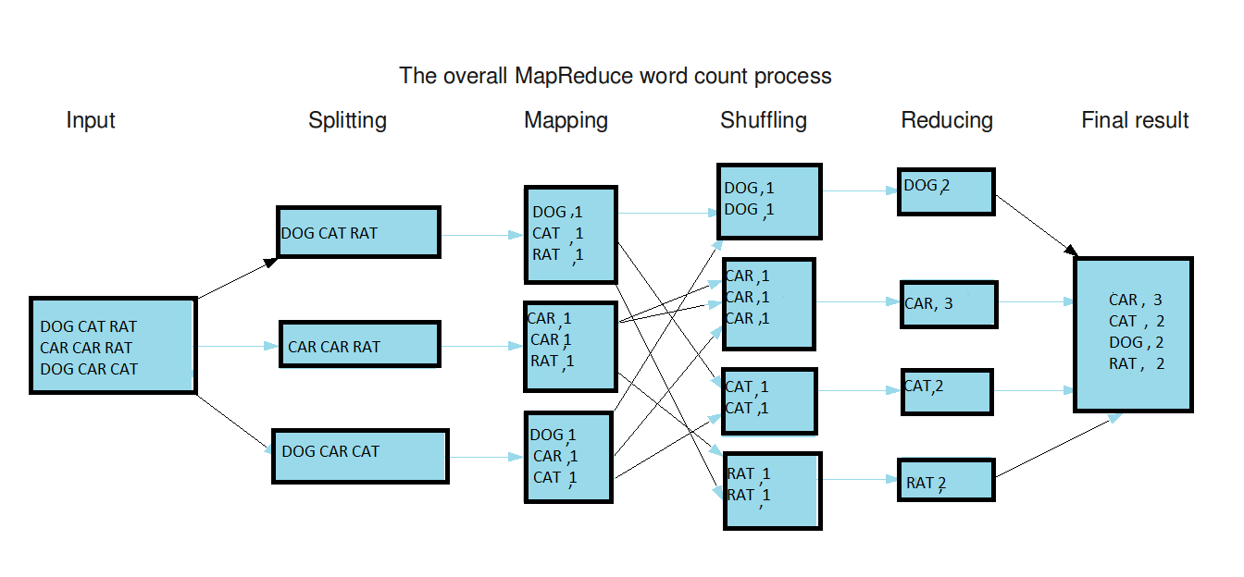
MapReduce
It is a programming model and processing technique used for handling and generating large datasets with a distributed algorithm on a cluster.
Objective: The objective of MapReduce is to process large data sets efficiently and reliably using a parallel, distributed algorithm.
Map Reduce

Slide 25
Introduction to Sqoop

Slide 26
What is Sqoop?
Apache Sqoop (SQL-to-Hadoop) is a tool designed for efficiently transferring bulk data between Apache Hadoop and structured data stores such as relational databases. Here are the key points about Sqoop:

Slide 27
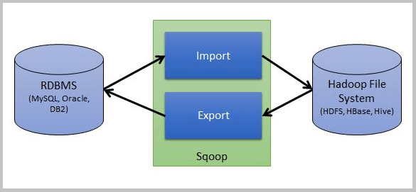
Sqoop Architecture
Here, one source is RDBMS like MySQL and other is a destination like Hbase or HDFS etc. and Sqoop performs the operation to perform import and export.

Slide 28
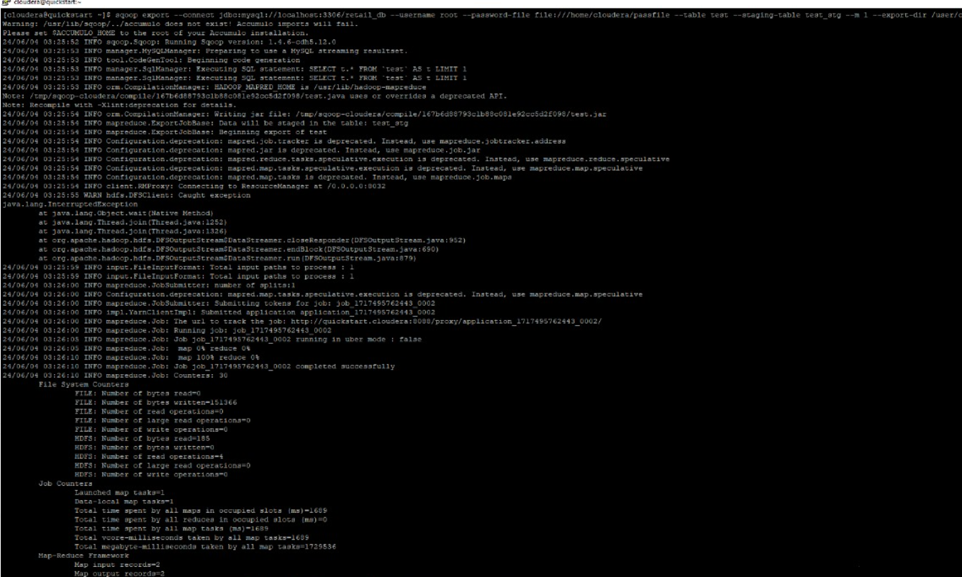

Slide 30
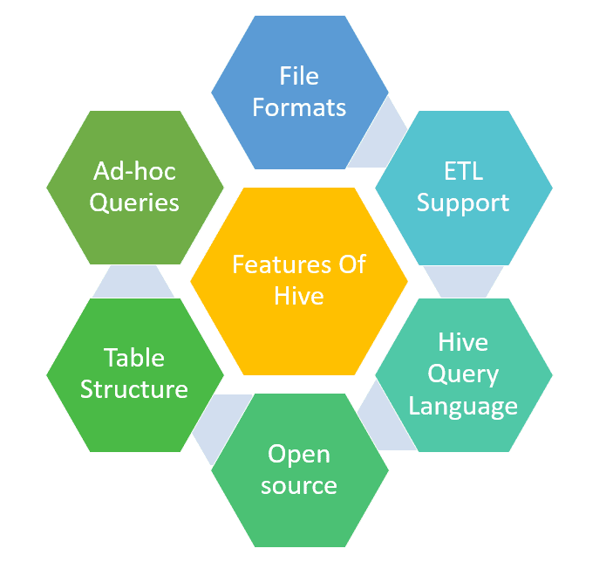
What is HIVE
Apache Hive is a data ware house system for Hadoop that runs SQL like queries called HQL (Hive query language) which gets internally converted to map reduce jobs.
Hive was developed by Facebook.
It supports Data definition Language, Data Manipulation Language and user defined functions.

Slide 31
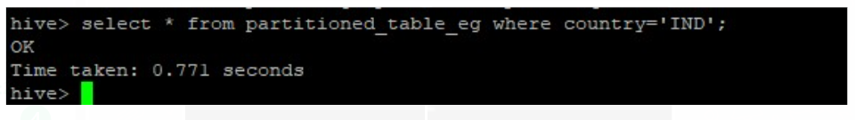
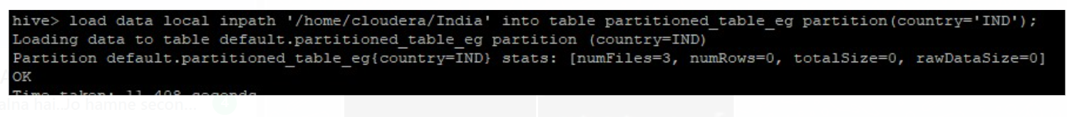

Slide 32
THANKS FOR WATCHING
https://github.com/Amit123456777
https://www.linkedin.com/in/amit-sharma-868b3a23a/
amsharma2607@gmail.com

